Slide 1
Algorithm Efficiency and Profiling

Slide 2
Learning Outcomes
Be able to compare algorithms using Big O Notation
Know the difference between rates of growth of common functions
Be able to use a profiler to measure performance of code

Slide 3
What is an algorithm?
an algorithm is a sequence of unambiguous instructions for solving a problem, i.e. for obtaining a required output for any legitimate input in a finite amount of time.
algorithm
problem
input
“computer”
output

Slide 4
Algorithm design and analysis process
understand the problem
decide on computational means: data structure(s), exact or approximate solving
design an algorithm
prove correctness
analyse the algorithm
code the algorithm

Slide 5
Complexity
In examining algorithm efficiency we must understand the idea of complexity
Space complexity
Time Complexity

Slide 6

Space Complexity
When memory was expensive we focused on making programs as space efficient as possible and developed schemes to make memory appear larger than it really was
Space complexity is still important in the field of embedded computing (hand held computer based equipment like cell phones, palm devices, etc)
ATARI 800XL – 64KB memory
HDD ➔ magnetic tape

Slide 7
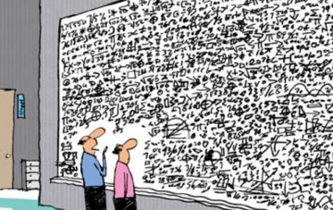
Time Complexity
Is the algorithm “fast enough” for my needs
How much longer will the algorithm take if I increase the amount of data it must process
Given a set of algorithms that accomplish the same thing, which is the right one to choose

Slide 8
Time Complexity
London
Madrid
New York
Berlin
Manchester
Direct flights
Visit all cities but ONLY once (starting from London and ending in London)

Slide 9
Time Complexity
London
Madrid
New York
Berlin
Manchester
Direct flights
Visit all cities but ONLY once (starting from London and ending in London)

Slide 10
Time Complexity
How long takes a program to find the path ?
Imagine worst scenario – a very large graph with many cities..
Very long – high time complexity

Slide 11
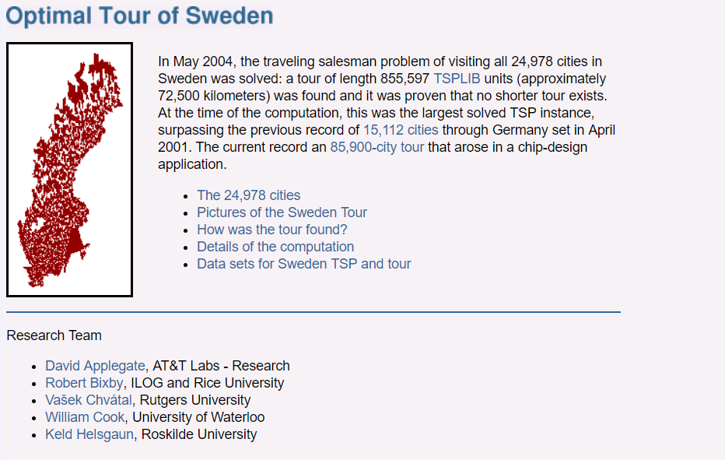
Time Complexity
8 years of computation time (in parallel of a network of computers)

Slide 12
Time Complexity
Understating the time complexity of programs and
finding fast algorithms are crucial aspects of computer science

Slide 13
Time Complexity
for (int i = 0; i <= n; i++)
{
m=5;
}
assignments
incrementing 1
comparator operator
time complexity = how many instructions are executed

Slide 14
Time Complexity
for (int i = 0; i <= n; i++)
{
m=5;
}
n = 0 5 instructions
assign 0 to i
compare i to n
continue if i<=n
assign 5 to m
increment i by 1

Slide 15
Time Complexity
for (int i = 0; i <= n; i++)
{
m=5;
}
n = 1 5 *2 = 10 instructions

Slide 16
Time Complexity
for (int i = 0; i <= n; i++)
{
m=5;
}
n = 2 5 *3 = 15 instructions

Slide 17
Time Complexity
for (int i = 0; i <= n; i++)
{
m=5;
}
n = 2 5 *3 = 15 instructions
number instructions (n) = 5 (n+1)

Slide 18
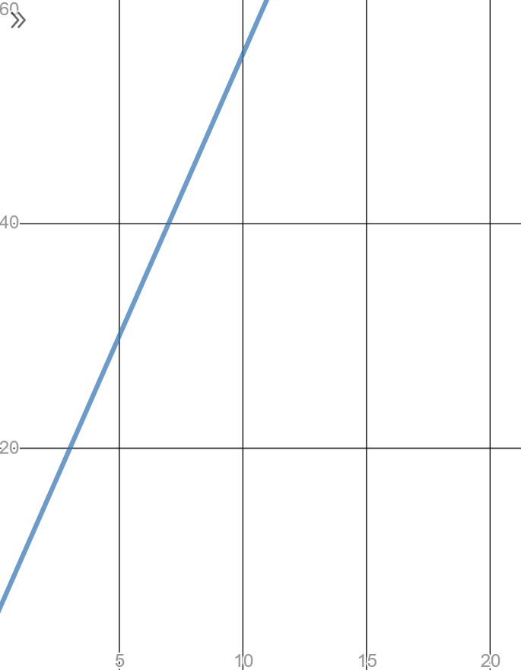
Time Complexity
Number
instructions
Use online graphing calculators
(desmos)
n
number instructions (n) = 5 (n+1)

Slide 19
Maximum Problem Size n
Running Time | 1 Second | 1 Minute | 1 Hour
400n | 2,500 | 150,000 | 9,000,000
20n(log n) | 4,096 | 166,666 | 7,826,087
2n² | 707 | 5,477 | 42,426
n⁴ | 31 | 88 | 244
2^{n} | 19 | 25 | 31
Notes:
Each operation can be solved in 1 microsecond

Slide 20
Does the choice of the Algorithm matter ?

Slide 21
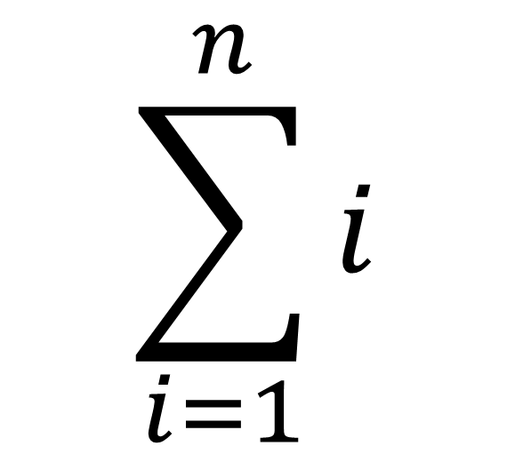
1 + 2 + 3 + 4 + …………….+ n

Slide 22
Method A
public int MethodA(int n)
{
int sum = 0;
for (int i = 1; i <= n; i++)
{
sum = sum + i;
}
return sum;
}

Slide 23
Method A
public int MethodA(int n)
{
int sum = 0;
for (int i = 1; i <= n; i++)
{
sum = sum + i;
}
return sum;
}
i
sum = sum + i;
1 + 2 + 3 + 4 + 5 + ……………….

Slide 24
Method B
public int MethodB(int n)
{
int sum = 0;
for (int i = 1; i <= n; i++)
{
for (int j = 1; j <= i; j++)
{
sum = sum + 1;
}
}
return sum;
}
i
1 + 2 + 3 +
1 + 1 + 1 + 1 + 1 + 1 + …
j
sum = sum + 1;

Slide 25
Method C
public int MethodC(int n)
{
return n * (n + 1) / 2;
}
no loop (it does not matter the value of n)

Slide 27
Frequency Count
examine a piece of code and predict the number of instructions to be executed
e.g.
for each instruction predict how many times each will be encountered as the code runs
Inst #
1
2
3
Code
for (int i=0; i< n ; i++)
{ cout << i;
p = p + i;
}
F.C.
n+1
n
n
____
3n+1
totaling the counts produces the F.C. (frequency count)
discarding constant terms produces : 3n
clearing coefficients : n
picking the most significant term: n
Big O = O(n)

Slide 28
Another example
Inst #
1
2
3
4
Code
for (int i=0; i< n ; i++)
for (int j=0 ; j < n; j++)
{ cout << i;
p = p + i;
}
F.C.
n+1
n(n+1)
n*n
n*n
F.C.
n+1
n²+n
n²
n²
____
3n²+2n+1
discarding constant terms produces : 3n²+2n
clearing coefficients : n²+n
picking the most significant term: n²
Big O = O(n²)

Slide 29
Orders of Growth
Function | Name
C | Constant
log N | Logarithmic
N | Linear
N log N | N log N
N² | Quadratic
N³ | Cubic
2^{N} | Exponential
N! | Factorial
very good
very bad

Slide 30
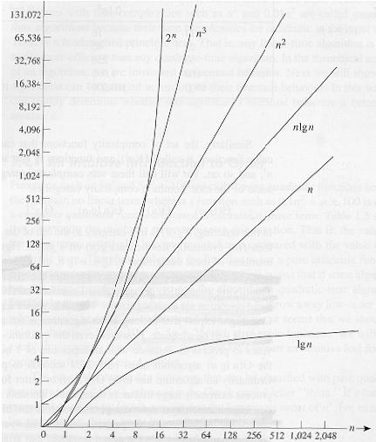
Common orders of magnitude
bad
not so good
good
very fast

Slide 31
Power Term Dominates
n | n³ | n³ + 500
1 | 1 | 501
2 | 8 | 508
3 | 27 | 527
4 | 64 | 564
5 | 125 | 625
6 | 216 | 716
7 | 343 | 843
8 | 512 | 1012
9 | 729 | 1229
10 | 1000 | 1500
11 | 1331 | 1831
12 | 1728 | 2228
13 | 2197 | 2697
14 | 2744 | 3244
Ratio 1 : 500
Ratio 1 : 1.1

Slide 32
Big O Examples
Just keep the term that grow fastest (and forgets constants)

Slide 33
Big O

Slide 34
Search in BST
Search if an item is present
Time complexity of Search
Think to the worst scenario

Slide 35
Search in BST
20
Search if an item is present
Time complexity of Search
Think to the worst scenario
searching for “1”
10
6
15
5
1

Slide 36
Search in BST
20
Search if an item is present
Time complexity of Search
Think to the worst scenario
searching for “1”
20 – 10 – 6 - 5 -1,
5 steps (5 nodes to be visited)
If the tree has n nodes -> O(n).
10
6
15
5
1

Slide 37
Search in BST
20
Search if an item is present
Time complexity of Search
Think to the worst scenario
searching for “1”
20 – 10 – 6 - 5 -1,
5 steps (5 nodes to be visited)
If the tree has n nodes -> O(n). Unbalanced
10
6
15
5
1

Slide 38
Search in an AVL Tree
Search if an item is present
Time complexity of Search
Think to the worst scenario
searching for “1”
10
5 20
1 6

Slide 39
Search in an AVL Tree
Search if an item is present
Time complexity of Search
Think to the worst scenario
searching for “1”
10 - 5 -1, 3 steps (3 nodes to be visited)
If the tree has n nodes -> O(logn)
10
5 20
1 6

Slide 40
Why AVL is better than BST ?
Search if an item is present
Time complexity of “search an item”
AVL tree with 10000 nodes the search takes O(logn), around 13 nodes to be visited
BST tree with 10000 nodes the search takes
O(n) , around 10000 nodes to be visited

Slide 41
Search in an AVL Tree
time
Search BST
Search AVL
number nodes

Slide 42
Big O Notation
Algorithm “search” executes
200 * (n) instructions to search for an item in a list of n nodes.
What is the big O notation of its time complexity ?
O(n)
O(n²)
O(n³)

Slide 43
Big O Notation
Algorithm “search” executes
200 * (n) instructions to search for an item in a list of n nodes.
What is the big O notation of its time complexity ?
O(n)
O(n²)
O(n³)

Slide 44
Time Complexity of this program?
for (int i=0; i< n ; i++)
for (int j=0 ; j < n; j++)
{ Console.writeline(“test”); }
O(n²)
O(n)
O(2^{n})

Slide 45
Time Complexity of this program?
for (int i=0; i< n ; i++)
for (int j=0 ; j < n; j++)
{ Console.writeline(“test”); }
O(n²)
O(n)
O(2^{n})

Slide 46
Time Complexity of this program?
for (int k =0; k <n; k++)
for (int i=0; i< n ; i++)
for (int j=0 ; j < n; j++)
{ Console.writeline(“test”); }
O(n²)
O(n³)
O(n)

Slide 47
Time Complexity of this program?
for (int k =0; k <n; k++)
for (int i=0; i< n ; i++)
for (int j=0 ; j < n; j++)
{ Console.writeline(“test”); }
O(n²)
O(n³)
O(n)

Slide 48
Which algorithm is faster
Algorithm 1 has time complexity O(n²)
Algorithm 2 has time complexity O(logn)
Algorithm 3 has time complexity O(n * logn)
Algorithm 1
Algorithm 2
Algorithm 3

Slide 49
Which algorithm is faster
Algorithm 1 has time complexity O(n²)
Algorithm 2 has time complexity O(logn)
Algorithm 3 has time complexity O(n * logn)
Hint:
Consider a very large n
n = 50
Algorithm 1
Algorithm 2
Algorithm 3

Slide 50
Which algorithm is faster
Algorithm 1 has time complexity O(n²)
Algorithm 2 has time complexity O(logn)
Algorithm 3 has time complexity O(n * logn)
Algorithm 1, for n = 50, n² = 2500
Algorithm 2, for n = 50, logn = 5.6
Algorithm 3, for n = 50, n *logn = 280
Algorithm 1
Algorithm 2
Algorithm 3

Slide 51
Which algorithm is faster
Algorithm 1 has time complexity O(n²)
Algorithm 2 has time complexity O(logn)
Algorithm 3 has time complexity O(n * logn)
Algorithm 1, for n = 50, n² = 2500
Algorithm 2, for n = 50, logn = 5.6
Algorithm 3, for n = 50, n *logn = 280
Algorithm 1
Algorithm 2
Algorithm 3

Slide 52
Using Big O
When Selecting an algorithm we normally consider Best, Worse and Average Cases
Average case is hard to prove so may only have Best or Worse case estimates
May have to consider other factors (eg. memory space), hardware limits

Slide 53
Other Static Code Metrics Values
Maintainability Index – Calculates an index value between 0 and 100 that represents the relative ease of maintaining the code. A high value means better maintainability and reusability.
Cyclomatic Complexity – Measures the structural complexity of the code. Higher cyclomatic complexity means larger number of tests needed.
Can compute both with Visual Studio

Slide 54
Cyclomatic Complexity
If your code has high cyclomatic complexity then it is hard to test it (needs many tests)
Usually adding IF-THEN increases the cyclomatic complexity

Slide 55
Cyclomatic Complexity
namespace ConsoleApp2
{ class Program
{
static void Main(string[] args)
{
}
}
}
cyclomatic complexity is 2

Slide 56
Cyclomatic Complexity
namespace ConsoleApp2
{ class Program
{
static void Main(string[] args)
{
Console.writeline(“test”);
}
}
}
cyclomatic complexity is 2

Slide 57
Cyclomatic Complexity
namespace ConsoleApp2
{
class Program
{
static void Main(string[] args)
{
int x = 5;
if (x==10)
{
Console.WriteLine("found");
}
}
}
}
cyclomatic complexity is 3

Slide 58
Cyclomatic Complexity
namespace ConsoleApp2
{
class Program
{
static void Main(string[] args)
{
int x = 5;
int y = 10;
if (x == 10)
{
if (y >20 )
{
Console.WriteLine("found");
}
}
}
}
} cyclomatic complexity is 4

Slide 59
Summary
Algorithm selection is crucial: No coding smarts can make up for bad algorithm selection.
When writing an algorithm always consider its efficiency (count instructions and use the Big O notation)
Check assumptions with profiler and optimize the code

